Slide 1

Security+
Exam SY0-601
Chapter 20
Wireless Security
Notes:
Gain Attention

Slide 2
Chapter 20 (Domain 3.4) Learning Objectives
Install and configure wireless security settings.
Cryptographic protocols
WiFi Protected Access 2 (WPA2)
WiFi Protected Access 3 (WPA3)
Counter-mode/CBC-MAC Protocol (CCMP)
Simultaneous Authentication of Equals (SAE)
Authentication protocols
Extensible Authentication Protocols (EAP)
Protected Extensible Authentication Protocol (PEAP)
EAP-FAST
EAP-TLS
EAP-TTLS
IEEE 802.1X
Remote Authentication Dial-in User Service (RADIUS) Federation
Methods
Pre-shared key (PSK) vs Enterprise vs Open
WiFi Protected Setup (WPS)
Captive portals
Installation considerations
Site survey
Heat maps
WiFi analyzers
Channel overlaps
Wireless access point (WAP) placement
Controller and access point security

Slide 3
Cryptographic Protocols
Wireless networks make physical security protections against rogue connections difficult.
This lack of a physical barrier makes protection against others eavesdropping on a connection also a challenge.
Cryptographic protocols are the standards used to describe cryptographic methods and implementations to ensure interoperability between different vendors’ equipment.

Slide 4
Cryptographic Protocols
The history of cryptographic protocols in wireless begins with Wired Equivalent Privacy (WEP) and then transitions to Wi-Fi Protected Access (WPA), but both of these fell to poor design.
WEP encrypts the data traveling across the network with an RC4 stream cipher, attempting to ensure confidentiality.
The flaw in WEP was that the initialization vector was of insufficient length to protect the channel.
WPA replaced WEP using TKIP
TKIP works by using a shared secret combined with the card’s MAC address to generate a new key, which is mixed with the initialization vector (IV) to make per-packet keys that encrypt a single packet using the same RC4 cipher used by traditional WEP.

Slide 5
Wi-Fi Protected Access 2 (WPA2)
IEEE 802.11i is the standard for security in wireless networks and is also known as Wi-Fi Protected Access 2 (WPA2).
It uses 802.1X to provide authentication and uses Advanced Encryption Standard (AES) as the encryption protocol.
WPA2 uses the AES block cipher with Counter Mode with Cipher Block-Chaining-Message Authentication Code Protocol (CCMP).
The WPA2-Personal passphrase can be cracked using brute force attacks.
Two version:
WPA2-Personal with Pre-Shared Key (PSK)
WPA2-Enterprise with 802.1x (Port-based Authentication)

Slide 6
Wi-Fi Protected Access 3 (WPA3)
Wi-Fi Protected Access 3 (WPA3) is the successor to WPA2.
WPA3 improves the security of the encryption by using Simultaneous Authentication of Equals (SAE) in place of the PSK authentication method used in prior WPA versions. (described later in this chapter)

Slide 7
Wi-Fi Protected Access 3 (WPA3)
WPA3-Enterprise brings a whole host of upgrades, including 192-bit minimum-strength security protocols and cryptographic tools such as the following:
Authenticated encryption 256-bit Galois/Counter Mode Protocol (GCMP-256)
Key derivation and confirmation 384-bit Hashed Message Authentication Code (HMAC) with Secure Hash Algorithm (HMAC-SHA-384)
Key establishment and authentication Elliptic Curve Diffie-Hellman (ECDH) exchange and Elliptic Curve Digital Signature Algorithm (ECDSA) using a 384-bit elliptic curve
Robust management frame protection 256-bit Broadcast/Multicast Integrity Protocol Galois Message Authentication Code (BIP-GMAC-256)

Slide 8
Wi-Fi Protected Access 3 (WPA3)
WPA3 integrates with the back-end enterprise authentication infrastructure, such as a RADIUS server.
It can use elliptic curve Diffie-Hellman exchanges and elliptic curve Digital Signature Algorithm (DSA) protocols to provide a method of strong authentication.
The WPA3 protocol makes use of a Quick Response (QR) code for users to connect their devices to the “Wi-Fi CERTIFIED Easy Connect” network, which allows them to scan a QR code on a device with their smartphone.
WPA3 offers forward secrecy based on its method of encryption; previous messages do not enable future decryption.

Slide 9
Counter Mode/CBC-MAC Protocol (CCMP)
CCMP stands for Counter Mode with Cipher Block Chaining–Message Authentication Code Protocol (or Counter Mode with CBC-MAC Protocol).
CCMP is a data encapsulation encryption mechanism designed for wireless use.
CCMP is actually the mode in which the AES cipher is used to provide message integrity.
Unlike WPA/TKIP, WPA2/CCMP requires new hardware to perform the AES encryption.

Slide 10
Simultaneous Authentication of Equals (SAE)
Simultaneous Authentication of Equals (SAE) is a password-based key exchange method developed for mesh networks.
Defined in RFC 7664, it uses the Dragonfly protocol to perform a key exchange and is secure against passive monitoring.
Uses zero-knowledge key generation method, it is resistant to active, passive, and dictionary attacks.
As a peer-to-peer protocol, it does not rely on other parties, so it is an alternative to using certificates or a centralized authority for authentication.

Slide 11
Authentication Protocols
Wireless networks have a need for secure authentication protocols.
The following authentication protocols should be understood for the Security+ exam:
EAP
PEAP
EAP-FAST
EAP-TLS
EAP-TTLS
IEEE 802.1X
RADIUS Federation.

Slide 12
Extensible Authentication Protocol (EAP)
The Extensible Authentication Protocol (EAP) is a protocol (authentication framework) for wireless networks that expands on authentication methods used by the Point-to-Point Protocol (PPP).
PPP is a protocol that was commonly used to directly connect devices to each other.
EAP is defined in RFC 2284 (obsoleted by 3748).
EAP can support multiple authentication mechanisms, including tokens, smart cards, certificates, one-time passwords, and public key encryption authentication.
EAP defines the format of authentication messages between client and authentication server
EAP has been expanded into multiple versions, some of which are covered in the following sections.

Slide 13
EAP-FAST
EAP-FAST (EAP Flexible Authentication via Secure Tunneling) is described in RFC 4851 and proposed by Cisco to be a replacement for LEAP, a previous Cisco version of EAP.
It offers a lightweight tunneling protocol to enable authentication.
The distinguishing characteristic is the passing of a Protected Access Credential (PAC) that is used to establish a TLS tunnel through which client credentials are verified.
The Wi-Fi Alliance added EAP-FAST to its list of supported protocols for WPA/WPA2/WPA3.

Slide 14
EAP-TLS
EAP-TLS is an Internet Engineering Task Force (IETF) open standard (RFC 5216) that uses the TLS protocol to secure the authentication process.
EAP-TLS relies on TLS, an attempt to standardize the Secure Sockets Layer (SSL) structure to pass credentials.
EAP-TLS for mutual authentication requires client and server certificates.
This means that an attacker must also possess the key for the client-side certificate to break the TLS channel.
The Wi-Fi Alliance added EAP-TLS to its list of supported protocols for WPA/WPA2/WPA3.

Slide 15
EAP-TTLS
EAP-TTLS (which stands for EAP–Tunneled TLS) is a variant of the EAP-TLS protocol.
EAP-TTLS works much the same way as EAP-TLS, with the server authenticating to the client with a certificate, but the protocol tunnels the client side of the authentication, allowing the use of legacy authentication protocols such as Password Authentication Protocol (PAP), Challenge-Handshake Authentication Protocol (CHAP), Microsoft Challenge Handshake Authentication Protocol (MS-CHAP), and MS-CHAP-V2.
In EAP-TTLS, the authentication process is protected by the tunnel from man-in-the-middle attacks, and although client-side certificates can be used, they are not required, making this easier to set up than EAP-TLS to clients without certificates.
The Wi-Fi Alliance added EAP-TTLS to its list of supported protocols for WPA/WPA2/WPA3

Slide 16
IEEE 802.1X
IEEE 802.1X is an authentication standard that supports port-based authentication services between a user and an authorization device, such as an edge router.
IEEE 802.1X is commonly used on wireless access points as a port-based authentication service prior to admission to the wireless network.
WPA2-Enterprise uses IEEE 802.1X to establish a secure connection between devices.
IEEE 802.1X over wireless uses either IEEE 802.11i or an EAP-based protocol such as EAP-TLS or PEAP-TLS.

Slide 17
Remote Authentication Dial-in User Service (RADIUS) Federation
Using a series of RADIUS servers in a federated connection has been employed in several worldwide RADIUS federation networks.
A user packages their credentials at a local access point using a certificate-based tunneling protocol method.
The first RADIUS server determines which RADIUS server to send the request to, and from there the user is authenticated via their home RADIUS server, and the results are passed back, permitting the joining to the network.

Slide 18
Remote Authentication Dial-in User Service (RADIUS) Federation
Because the credentials must pass multiple different networks, the EAP methods are limited to those with certificates and credentials to prevent loss of credentials during transit.
This type of federated identity at global scale demonstrates the power of RADIUS and EAP methods.
RADIUS federation allows users to use their normal credentials across trusted networks.
This allows users in one organization to authenticate and access resources on another trusted organization’s network using one set of credentials.

Slide 19
Methods
Authentication methods are used to provide authentication services (in the case of wireless networks, remotely) through the configuration of the protocols used to protect the communication channel.
This section covers the configuration of the systems so that the protocols can be employed in a secure manner.

Slide 20
Pre-shared Key (PSK) vs. Enterprise vs. Open
PSK:
A PSK is typically entered as a passphrase of up to 63 characters.
This key must be securely shared between users
Enterprise:
devices use IEEE 802.1X and a RADIUS authentication server to enable a connection.
This method allows the use of usernames and passwords and provides enterprise-class options such as network access control (NAC) integration and multiple random keys
Open:
Not truly authentication; merely sharing of a secret key based on the SSID

Slide 21
Wi-Fi Protected Setup (WPS)
Wi-Fi Protected Setup (WPS) is a network security standard created to provide users with an easy method of configuring wireless networks.
Designed for home networks and small business networks, this standard involves the use of an eight-digit PIN to configure wireless devices.
WPS consists of a series of EAP messages and has been shown to be susceptible to a brute force attack.
A successful attack can reveal the PIN, and subsequently the WPA/WPA2 passphrase, and allow unauthorized parties to gain access to the network.
The Wi-Fi Alliance deprecated WPS.

Slide 22
Captive Portals
Captive portal refers to a specific technique of using an HTTP client to handle authentication on a wireless network.
Frequently employed in public hotspots, a captive portal opens a web browser to an authentication page.
This occurs before the user is granted admission to the network.
The access point uses this simple mechanism by intercepting all packets and returning the web page for login.
The actual web server that serves up the authentication page can be in a walled-off section of the network, blocking access to the Internet until the user successfully authenticates.
Not to be confused with CAPTCHA

Slide 23
Installation Considerations
Installing wireless system in a home is easy.
In an enterprise, where multiple access points will be needed, the configuration takes significantly more work.
Site surveys are needed to determine proper access point and antenna placement, as well as channels and power levels.
Elements that have to be considered are based on signal propagation and interference.
Signal propagation is a function of antennas, signal strength, and the physical layout of a facility, including intervening structures.
These are all addressed using site surveys, Wi-Fi analyzers, and software to optimize access point placement.

Slide 24
Site Surveys
A site survey involves several steps: mapping the floor plan, testing for RF interference, testing for RF coverage, and analyzing material via software.
The software can suggest placement of access points. This is an example of a predictive site survey analysis.
After deploying the APs, you survey the site again, mapping the results versus the predicted analysis while watching signal strength and signal-to-noise ratios.
Another important use of site surveys is the auditing of existing wireless networks to find areas of degraded performance or even rogue access points.

Slide 25
Heat Maps
A Wi-Fi heat map is a map of wireless signal coverage and strength.
Typically, a heat map shows a layout of a room, floor, or facility overlaid by a graphical representation of a wireless signal.
Heat maps are created using a Wi-Fi analyzer and software to allow the analysis of Wi-Fi signal strength in the form of a graphical layout.
This allows network administrators to find areas of weak signals and consider alternative access point placement.
Not to confused with “heat map” as it relates to Risk Management.

Slide 26
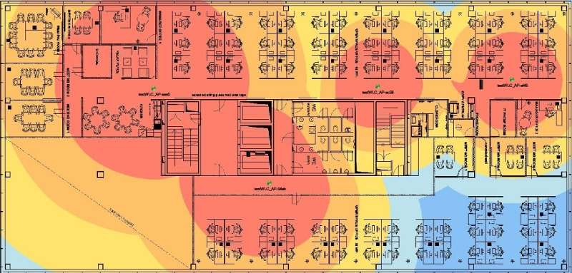
Heat Maps

Slide 27
Wi-Fi Analyzers
Wi-Fi analyzers provide a means of determining signal strength and channel interference.
A Wi-Fi analyzer is an RF device used to measure signal strength and quality.
It can determine if the Wi-Fi signal strength is sufficient, and if there are competing devices on a particular channel.
This enables an engineer to allocate signals both in strength and channel to improve Wi-Fi performance.

Slide 28
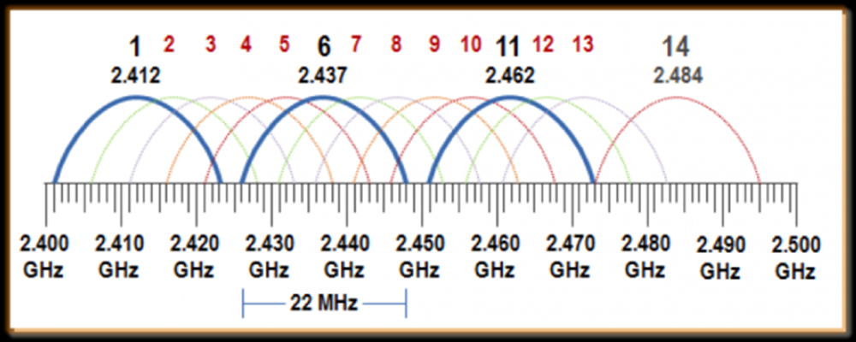
Channel Overlays
Wi-Fi radio signals exist at specific frequencies:
2.4 GHz and 5.0 GHz.
Each of these signals is broken into a series of channels
Up to 14 channels in the 2.4 GHz range
1, 6, 11 are non-overlapping channels

Slide 29
Channel Overlays
Beyond just improving channel overlay issues, the Wi-Fi Alliance has improved system throughput through the use of newer standards, including 802.11ac and 802.11ax.
These systems use a set of different encoding mechanisms and frequency allocations to increase throughput in dense Wi-Fi environments such as large public gatherings.
These methods are referred to as Wi-Fi 6 or, in the case of 802.11ax specifically, High Efficiency Wireless (HEW).

Slide 30
Wireless Access Point (WAP) Placement
Access points considerations:
Power
Network connectivity to infrastructure
Wi-Fi extenders; loss of throughput
Protecting from physical access to wireless access point
Bad coverage
Signal bleed

Slide 31
Controller and Access Point Security
Wireless access points are physical connections to your network infrastructure and should be guarded as such.
Proper controller and access point security provisions include both physical and logical security precautions.
The case of logical security has been the main focus of this chapter, keeping unauthorized users from accessing the channels.
Physical security is just as important, if not more so, and the actual devices and network connections should be placed in a location that is not readily accessible to an attacker.
This is especially true for exterior connections where no one would observe someone physically manipulating the device.

